Slide 1
AUTOMATED TIMETABLE GENERATION SYSTEM
Jabalpur Engineering College (JEC)
Jabalpur
SUBMITTED BY
Khushi (0201IT193D02)
Yash Narang (0201IT193D09)
Mishra Deepak (0201IT193D05)

Slide 2
Content
Introduction
Objective
Literature Survey
Use Case Diagram
Data Flow Diagram
Conclusion

Slide 3
Introduction
Automatic Timetable Generation system is a Desktop based software used to generate timetable automatically. Currently timetable is managed manually. It will help to manage all the lectures automatically.
Maximum and minimum workload for a Faculty for a day, week and month will be specified for the efficient generation of timetable. It is a comprehensive timetable management solutions for Colleges which help to overcome the challenges in manually setting the timetable.

Slide 4
Objective
Its is software for Automated Timetable Generation System for schools and colleges.
Sometimes there are limited faculties, each faculty teaching more than one subjects. So now the timetable needed to schedule the faculty at provided time slots in such very that their things do not overlap and the time table schedule makes best use of all faculty subjects demands.

Slide 5
Hardware /Software Requirement
Hardware Requirements (min)
Processor – Dual Core
Hard Disk – 50 GB
Memory – 1GB RAM
Software Requirements (min)
Windows 7
MYSQL 5.5
Easy PHP Deserver 14.1VC11

Slide 6

Use Case Diagram
Create Timetable
Add Subjects
View Timetable
Modify Timetable
Admin
Add Classroom
Add Teachers
Allocation

Slide 7
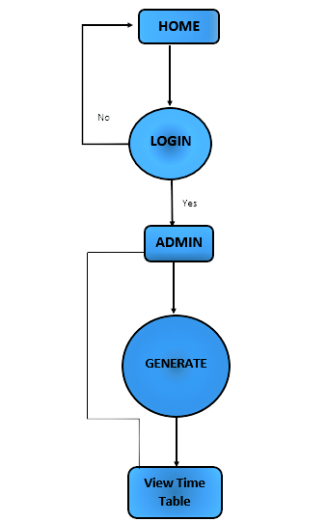
Data flow Diagram

Slide 8
Conclusion
So we conclude that is system which was developed by our team has perfectly meets the maximum requirements and the whole efforts was spend by our team has given the best quality of output. We now that this software has some limitations but, this is our highest limit of optimization of the system.in analysis we studied about the and problem and after this we planned a best solution for the core problem. And now, we finally implemented the automated timetable generation system as a timetable generator tool according to the solution we planned.

